Slide 1
EECS 498 System Design of a Search Engine
Winter 2026
Lecture 10: TCP/IP DNS and Sockets
Nicole Hamilton
https://web.eecs.umich.edu/~nham/
nham@umich.edu

Slide 2
agenda
details
group photo survey results
read a webpage
TCP/IP
DNS
Sockets
LinuxGetUrl

Slide 3
agenda
details
group photo survey results
read a webpage
TCP/IP
DNS
Sockets
LinuxGetUrl

Slide 4
details
Time to begin building your engines.
  What classes and public members do you need?
  How many main( ) routines will there be?
  What file or message formats will you use?
  If you pass messages, do you batch them?
  Will you use scripts/make/your own main( ) to run the whole thing?

Slide 5
agenda
details
group photo survey results
read a webpage
TCP/IP
DNS
Sockets
LinuxGetUrl

Slide 6
survey results
Your team’s individualized report and grade has been posted to Canvas.
Your own grade for percent of required responses you entered will be posted soon.

Slide 7
survey results
I can show you the standings but not the final scores because I’m using them for grading.
Even though I can’t show you the final scores, I can report there’s not much difference between first and last place.
It’s very unlikely to change anyone’s final grades.
You all did well.

Slide 8

14

Slide 9
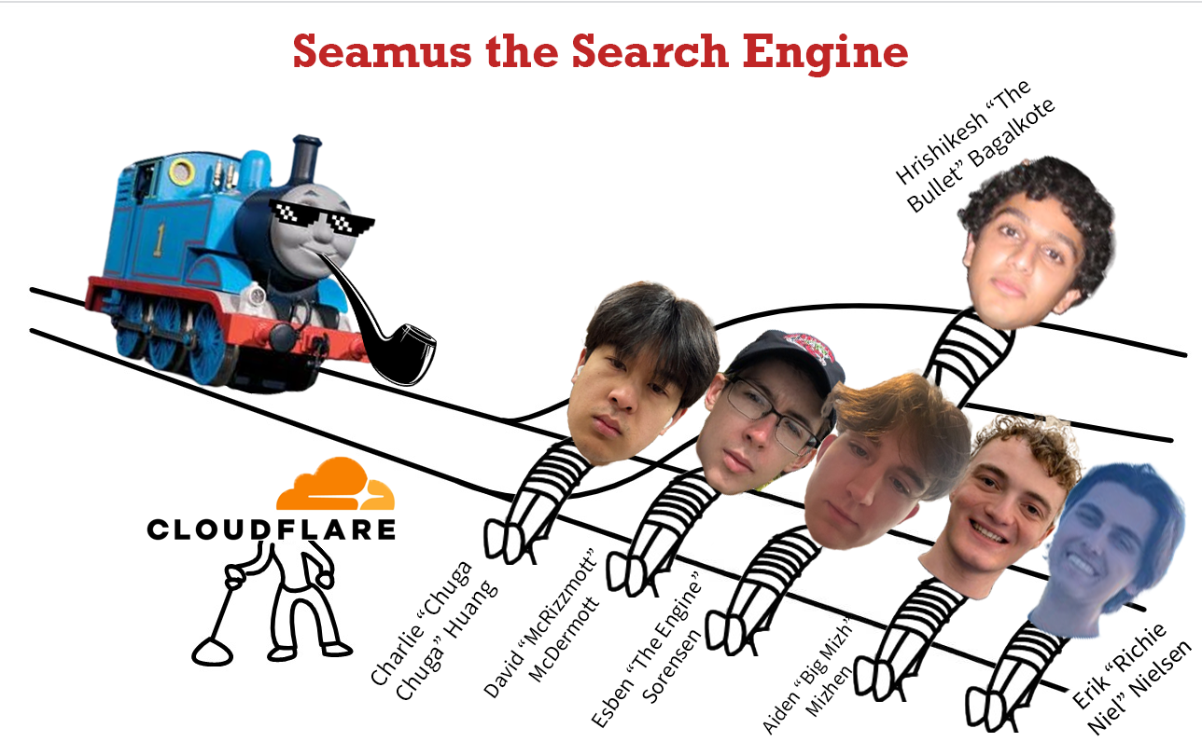
13

Slide 10

12

Slide 11
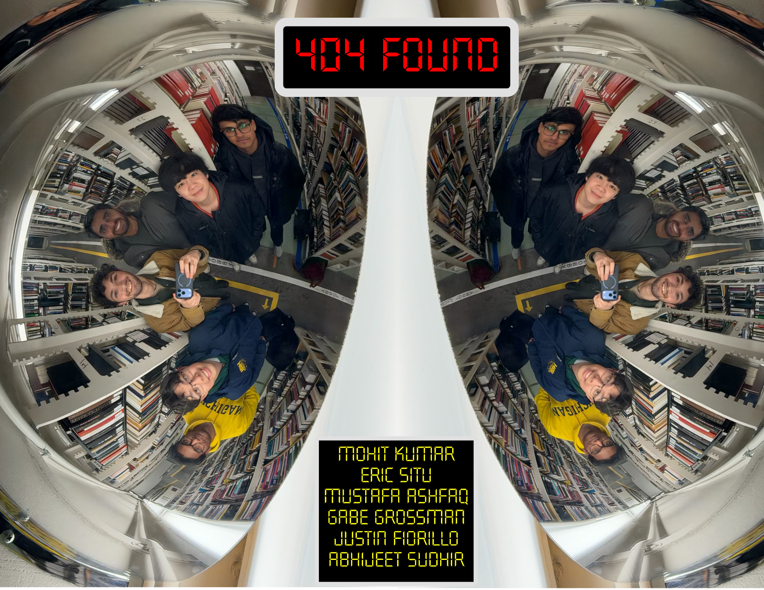
11

Slide 12
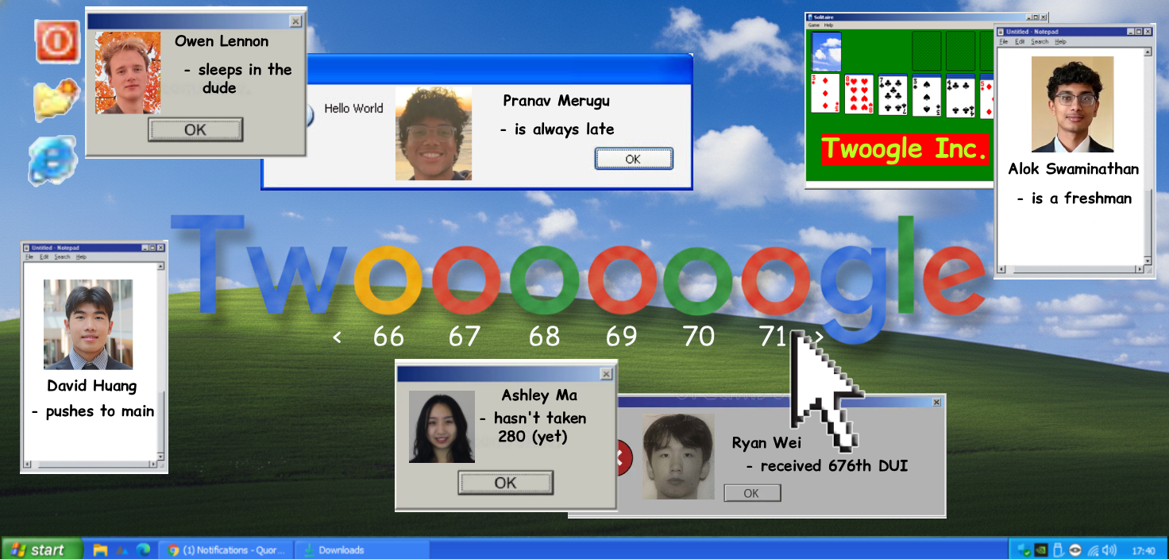
10

Slide 13

9

Slide 14

8

Slide 15

7

Slide 16

6

Slide 17

5

Slide 18

4

Slide 19

3

Slide 20
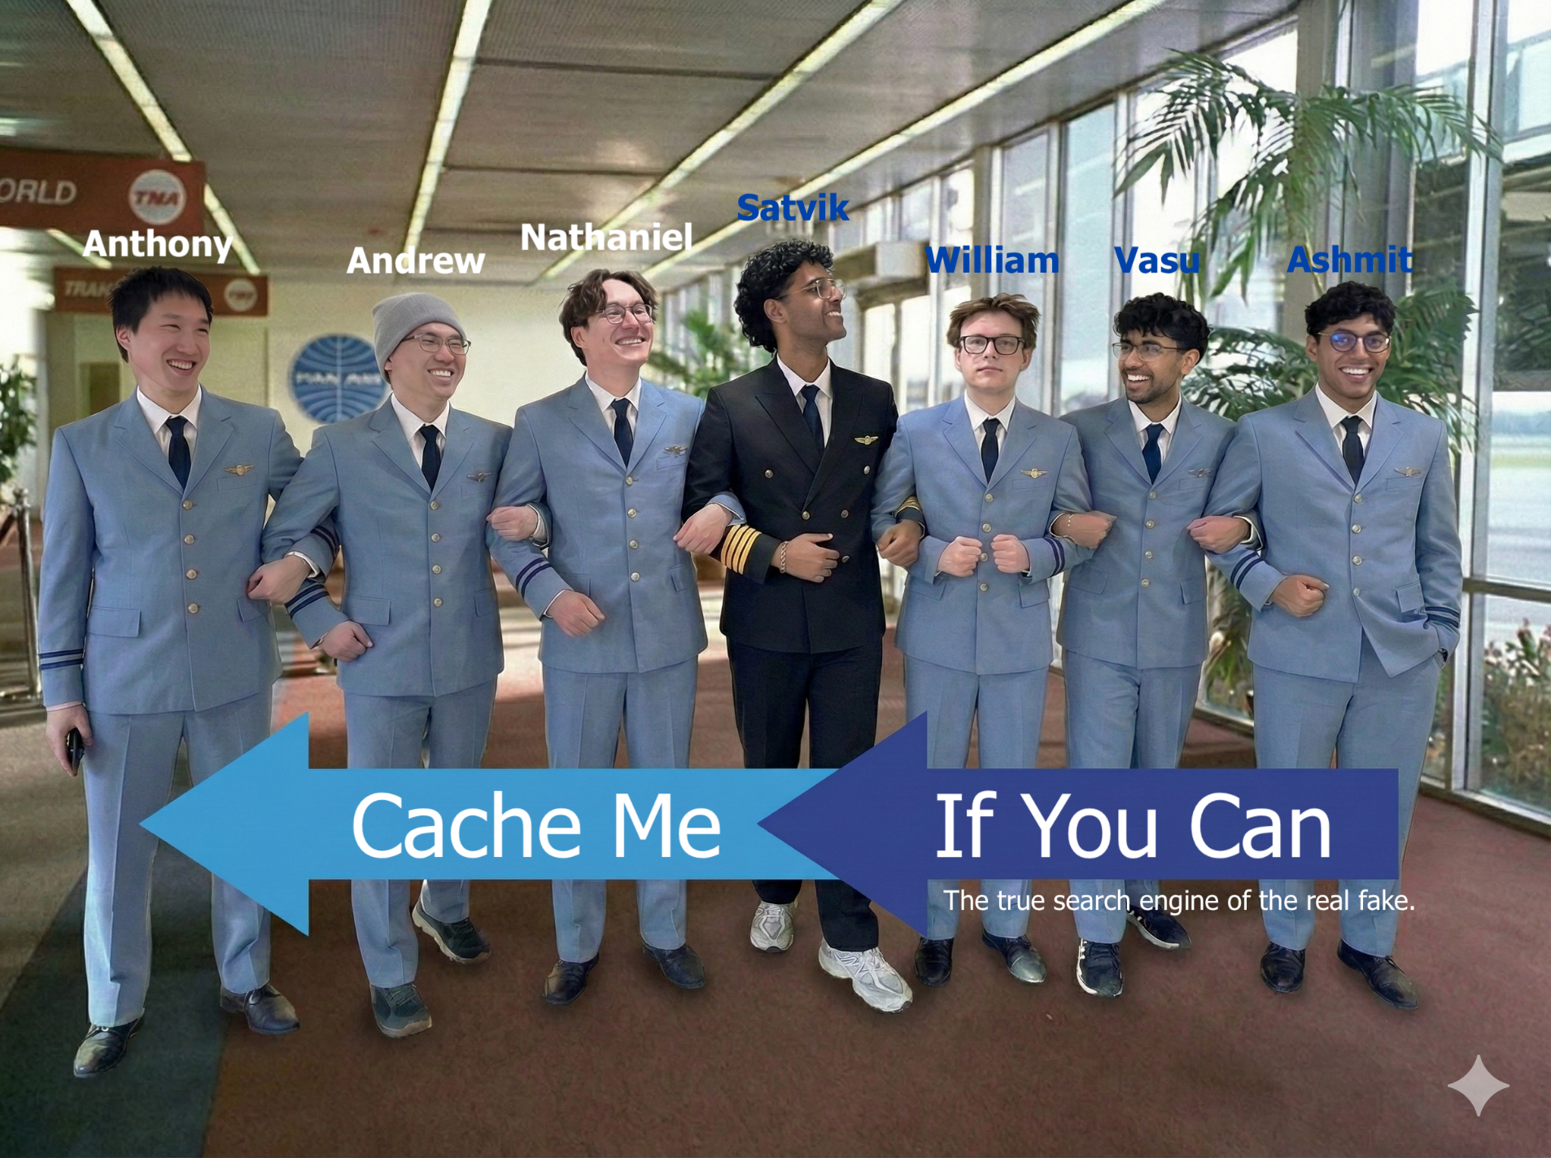
2

Slide 21

1

Slide 22
final standings
Check Engine Light
Cache Me If You Can
Crawl Me Maybe
Browser Juniors
OSeans 7
The Most Most Wanted
The Avengineers
The Ranking Hat
I’m Feeling Lucky
Twoogle
404 Found
bing chilling
Seamus the Search Engine
Closed AI
They were all good. I hope you had fun.

Slide 23
agenda
details
group photo survey results
read a webpage
TCP/IP
DNS
Sockets
LinuxGetUrl

Slide 24
HTTP over TCP/IP
Browser
Website
Imagine the connection between a browser and a website as a long pipe.
At each end is a socket you can read or write from as if it was a file.
Anything written into one end pops out and can be read at the other.

Slide 25
HTTP over TCP/IP
Browser
Website
To read a page from a website:
Look up the TCP/IP address of the website.
Create a socket.
Connect the socket to that address.
Send a GET message to request the page.
Read what comes back.

Slide 26
reading and serving webpages
Today, we’ll discuss the first of three small homework projects:
LinuxGetUrl Read an HTTP page.
LinuxGetSsl Read an HTTPS page.
LinuxTinyServer A simple HTTP server.

Slide 27
Here’s LinuxTinyServer.
tcsh-3% head LinuxTinyServer.cpp
// Linux tiny HTTP server.
// Nicole Hamilton nham@umich.edu
// This variation of LinuxTinyServer supports a simple plugin interface
// to allow "magic paths" to be intercepted.
// Usage: LinuxTinyServer port rootdirectory
// Compile with g++ -pthread LinuxTinyServer.cpp -o LinuxTinyServer
// To run under WSL (Windows Subsystem for Linux), must elevate with
tcsh-4% ls website
Images Styles index.htm
tcsh-5% ./LinuxTinyServer 5000 website
Listening on 0.0.0.0:5000

Slide 28
LinuxGetUrl does an HTTP Get.
tcsh-5% head LinuxGetUrl.cpp
// Linux get URL utility that copies the HTTP page to stdout.
// Nicole Hamilton nham@umich.edu
#include <unistd.h>
#include <sys/types.h>
#include <sys/socket.h>
#include <netdb.h>
#include <iostream>
#include <string.h>
#include <string>
tcsh-6% LinuxGetUrl
Usage: LinuxGetUrl url
tcsh-7% ./LinuxGetUrl http://localhost:5000/index.htm | head -20
Service = http, Host = localhost, Port = 5000, Path = index.htm
Host address length = 16 bytes
Family = 2, port = 5000, address = 127.0.0.1
GET /index.htm HTTP/1.1
Host: localhost
User-Agent: LinuxGetUrl/2.0 nham@umich.edu (Linux)
Accept: */*
Accept-Encoding: identity
Connection: close

Slide 29
The server sees the Get request and returns the file.
tcsh-5% ./LinuxTinyServer 5000 website
Listening on 0.0.0.0:5000
Connection accepted from 127.0.0.1:56032
GET /index.htm HTTP/1.1
Host: localhost
User-Agent: LinuxGetUrl/2.0 nham@umich.edu (Linux)
Accept: */*
Accept-Encoding: identity
Connection: close
Requested path = /index.htm
Actual path = website/index.htm
HTTP/1.1 200 OK
Content-Length: 8964
Connection: close
Content-Type: text/html

Slide 30
LinuxGetUrl reads the file.
tcsh-7% ./LinuxGetUrl http://localhost:5000/index.htm | head -20
Service = http, Host = localhost, Port = 5000, Path = index.htm
Host address length = 16 bytes
Family = 2, port = 5000, address = 127.0.0.1
GET /index.htm HTTP/1.1
Host: localhost
User-Agent: LinuxGetUrl/2.0 nham@umich.edu (Linux)
Accept: */*
Accept-Encoding: identity
Connection: close
HTTP/1.1 200 OK
Content-Length: 8964
Connection: close
Content-Type: text/html
<!DOCTYPE html PUBLIC "-//W3C//DTD XHTML 1.0 Strict//EN"
"http://www.w3.org/TR/xhtml1/DTD/xhtml1-strict.dtd">
<html xmlns="http://www.w3.org/1999/xhtml">
tcsh-8%

Slide 31
Errors are reported as 404 and other codes.
tcsh-2% ./LinuxGetUrl http://localhost:5000/zork.htm
Service = http, Host = localhost, Port = 5000, Path = zork.htm
Host address length = 16 bytes
Family = 2, port = 5000, address = 127.0.0.1
GET /zork.htm HTTP/1.1
Host: localhost
User-Agent: LinuxGetUrl/2.0 nham@umich.edu (Linux)
Accept: */*
Accept-Encoding: identity
Connection: close
HTTP/1.1 404 Not Found
Content-Length: 0
Connection: close
tcsh-3%

Slide 32
We’ll now go through the mechanics of making this happen.

Slide 33
agenda
details
read a webpage
TCP/IP
DNS
Sockets
LinuxGetUrl

Slide 34
TCP/IP Model
DHCP, DNS, FTP, HTTP, HTTPS, POP, SMTP, SSH, etc.
Application
TCP and UDP
Transport
IP address: IPv4 or IPv6
Internet
Link level: MAC address
Physical: Cable, fiber, wireless
Network Access

Slide 35
the application layer
DHCP, DNS, FTP, HTTP, HTTPS, POP, SMTP, SSH, etc.
Application
Transport
The application layer uses the reliable (or not!) messaging facilities provided by the lower levels.
Internet
Network Access

Slide 36
the application layer
DHCP, DNS, FTP, HTTP, HTTPS, POP, SMTP, SSH, etc.
Application
Transport
Dynamic Host Configuration Protocol (DHCP) is a network protocol that automatically assigns IP addresses to devices on a network.
Internet
Network Access

Slide 37
the application layer
DHCP, DNS, FTP, HTTP, HTTPS, POP, SMTP, SSH, etc.
Application
Transport
Domain Name System (DNS) translates domain names into IP addresses by asking a name server.
Internet
Network Access

Slide 38
the application layer
DHCP, DNS, FTP, HTTP, HTTPS, POP, SMTP, SSH, etc.
Application
Transport
File Transfer Protocol (FTP) is a standard protocol for transferring files between computers.
Internet
Network Access

Slide 39
the application layer
DHCP, DNS, FTP, HTTP, HTTPS, POP, SMTP, SSH, etc.
Application
Transport
You already know HTTP and HTTPS as the protocols for web pages.
Internet
Network Access

Slide 40
the application layer
DHCP, DNS, FTP, HTTP, HTTPS, POP, SMTP, SSH, etc.
Application
Transport
Post Office Protocol (POP) and Simple Mail Transfer Protocol (SMTP) support email exchange.
Internet
Network Access

Slide 41
the application layer
DHCP, DNS, FTP, HTTP, HTTPS, POP, SMTP, SSH, etc.
Application
Transport
Secure Shell (SSH) allows secure remote login.
Internet
Network Access

Slide 42
the transport layer
TCP and UDP
Application
Transport
Transmission Control Protocol (TCP) provides reliable end-to-end byte streams across the internet.
Internet
Network Access

Slide 43
the transport layer
TCP and UDP
Application
Transport
User Datagram Protocol (UDP) sends unreliable data packets over the internet. It's used for time-sensitive applications like video streaming, gaming, and DNS lookups.
Internet
Network Access

Slide 44
internet layer
IP address: IPv4 or IPv6
Application
Transport
Internet Protocol (IP) assigns IP addresses, routes packets, assembles packets into datagrams.
IPv4 uses 32-bit addresses. IPv6 uses 128-bit addresses.
Internet
Network Access

Slide 45
IP routing
Uses a routing table to select a next hop router.
Given a destination IP address, D, and network prefix, N:
  if ( N matches a directly connected network address )
  Deliver datagram to D over that network link;
  else if ( The routing table contains a route for N )
  Send datagram to the next-hop address listed in the routing table;
  else if ( a default route exists )
  Send datagram to the default route;
  else
  Send a forwarding error message to the originator;

Slide 46
network layer
Link level: MAC address
Physical: Cable, fiber, wireless
Application
Transport
Internet
Network Access

Slide 47
network layer
Link level: MAC address
Physical: Cable, fiber, wireless
Application
Transport
Media Access Control (MAC) address is a unique factory-assigned 12-digit hexadecimal number identifier for a device on a network.
Internet
Network Access

Slide 48
agenda
details
read a webpage
TCP/IP
DNS
Sockets
LinuxGetUrl

Slide 49
to get an IP address
Parse the HTTPS path to identify the host (domain name) we’re trying to reach.
Find the IP address for that host using a Domain Name Server (DNS).

Slide 50
DNS records
Type Name Value TTL Actions
A @ 160.153.46.5 600 seconds
A admin 160.153.46.5 600 seconds
A mail 160.153.46.5 600 seconds
:
CNAME webmail @ 1 Hour
CNAME www @ 1 Hour
:
MX @ mail.hamiltonlabs.com (Priority: 0) 1 Hour Edit
NS @ ns61.domaincontrol.com 1 Hour
NS @ ns62.domaincontrol.com 1 Hour
SOA @ Primary nameserver: ns61.domaincontrol.com. 600 seconds
An A record defines a host address.
A CNAME record defines a canonical name for alias.
An MX (Mail eXchange) record defines a mail server.
An NS record defines a name server.
An SOA (Start of Authority) defines the primary name server.

Slide 51
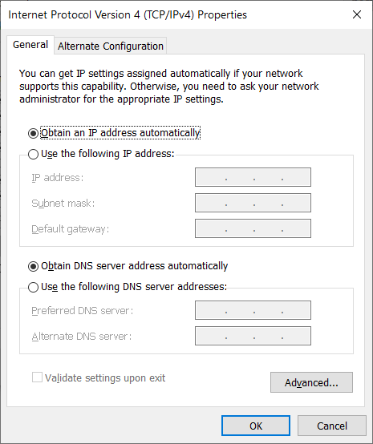
DHCP
We usually rely on DHCP (Dynamic Host Configuration Protocol) to assign an IP address to our machine and DNS server.

Slide 52
Let’s assume a simple mechanism for parsing a full URL into the components.
class ParsedUrl
{
public:
const char *CompleteUrl;
char *Service,
*Host,
*Port,
*Path;
ParsedUrl( const char *url );
~ParsedUrl( );
};

Slide 53
Example use:
ParsedUrl url( "http://localhost:5000/index.htm" );
cout << "Service = " << url.Service <<
", Host = " << url.Host <<
", Port = " << url.Port <<
", Path = " << url.Path << endl;
Should print:
Service = http, Host = localhost, Port = 5000, Path = index.htm

Slide 54
#include <sys/types.h>
#include <sys/socket.h>
#include <netdb.h>
int getaddrinfo(const char *node, const char *service,
const struct addrinfo *hints,
struct addrinfo **res);
void freeaddrinfo(struct addrinfo *res);
Given node and service, which identify an Internet host and a service, getaddrinfo() returns one or more addrinfo structures, each of which contains an Internet address that can be specified in a call to bind(2) or connect(2) to that website.

Slide 55
Here’s an example use.
// Get the host address, supplying hints for
// what we're looking for.
struct addrinfo *address, hints;
memset( &hints, 0, sizeof( hints ) );
hints.ai_family = AF_INET;
hints.ai_socktype = SOCK_STREAM;
hints.ai_protocol = IPPROTO_TCP;
int getaddrResult = getaddrinfo( url.Host,
*url.Port ? url.Port : "80", &hints, &address );
Later, it must be freed.
freeaddrinfo( address );

Slide 56
This is what the addrinfo structure looks like. It contains an Internet address that can be specified in a call to bind(2) or connect(2).
struct addrinfo {
int ai_flags;
int ai_family;
int ai_socktype;
int ai_protocol;
socklen_t ai_addrlen;
struct sockaddr *ai_addr;
char *ai_canonname;
struct addrinfo *ai_next;
};
The interesting part is the ai_addr, the actual IP address, which we can print.
PrintAddress( ( sockaddr_in * )address->ai_addr,
sizeof( struct sockaddr ) );

Slide 57
Here’s a simple print routine.
void PrintAddress( const sockaddr_in *s, const size_t saLength )
{
const struct in_addr *ip = &s->sin_addr;
uint32_t a = ntohl( ip->s_addr );
cout << "Host address length = " << saLength << " bytes" << endl;
cout << "Family = " << s->sin_family <<
", port = " << ntohs( s->sin_port ) <<
", address = " << ( a >> 24 ) << '.' <<
( ( a >> 16 ) & 0xff ) << '.' <<
( ( a >> 8 ) & 0xff ) << '.' <<
( a & 0xff ) << endl;
}

Slide 58
Example use:
int getaddrResult = getaddrinfo( "www.nytimes.com", "80",
&hints, &address );
PrintAddress( ( sockaddr_in * )address->ai_addr,
sizeof( struct sockaddr ) );
Should print:
Host address length = 16 bytes
Family = 2, port = 80, address = 151.101.185.164

Slide 59
agenda
details
read a webpage
TCP/IP
DNS
Sockets
LinuxGetUrl

Slide 60
#include <unistd.h>
#include <sys/types.h>
#include <sys/socket.h>
int socket(int domain, int type, int protocol);
int close(int fd);
socket() creates an endpoint for communication and returns a file descriptor that can be used for reading and writing.

Slide 61
#include <unistd.h>
#include <sys/types.h>
#include <sys/socket.h>
int socket(int domain, int type, int protocol);
int close(int fd);
The domain argument specifies a communication domain. Here are the most common:
Name Purpose
AF_UNIX, AF_LOCAL Local communication
AF_INET IPv4 Internet protocols
AF_INET6 IPv6 Internet protocols

Slide 62
#include <unistd.h>
#include <sys/types.h>
#include <sys/socket.h>
int socket(int domain, int type, int protocol);
int close(int fd);
The socket has the indicated type, which specifies the communication semantics. The most common is SOCK_STREAM, a sequenced, reliable connection with two-way byte streams.
The protocol is usually IPPROTO_TCP.

Slide 63
#include <sys/types.h>
#include <sys/socket.h>
int connect(int sockfd, const struct sockaddr *addr,
socklen_t addrlen);
connect() connects the socket to the specified IP address. The addrlen argument specifies the size of addr structure.

Slide 64
Here’s an example creating a socket and connecting it to an address.
// Create a TCP/IP socket.
int s = socket( AF_INET, SOCK_STREAM, IPPROTO_TCP );
assert( s != -1 );
// Connect the socket to the host address.
int connectResult = connect( s, address->ai_addr,
sizeof( struct sockaddr ) );
assert( connectResult == 0 );

Slide 65
#include <sys/types.h>
#include <sys/socket.h>
ssize_t send(int sockfd, const void *buf, size_t len, int flags);
ssize_t recv(int sockfd, void *buf, size_t len, int flags);
send() writes data into the socket. recv() reads data. Flags allow close-on-exec, noblocking reads/writes and other options.
The only difference between send() and write() or between recv() and read() is the presence of the optional flags. With a zero flags argument, send() is equivalent to write() and recv() is equivalent to read().

Slide 66
Here’s a sample GET message we might send. Notice that the User-agent field must contain your contact info in 440.
GET / HTTP/1.1
Host: www.nytimes.com
User-Agent: LinuxGetUrl/2.0 nham@umich.edu (Linux)
Accept: */*
Accept-Encoding: identity
Connection: close
Some sites will not even respond without a User-Agent field. It’s a free text field and can be anything as long as it exists. It’s typically the name of the software product that generated the Get + a slash followed by a version number. The OS or build environment is usually given in parens.
The Accept: and Accept-Encoding: fields are not required but typically provided.

Slide 67
Here’s an example sending the Get message over socket s.
string getMessage;
:
send( s, getMessage.c_str( ), getMessage.length( ), 0 );

Slide 68
Here’s an example reading from a socket and writing to stdout.
char buffer[ 10240 ];
int bytes;
while ( ( bytes = recv( s, buffer, sizeof( buffer ), 0 ) ) > 0 )
write( 1, buffer, bytes );
We’ll talk more about read( ) and write( ) when we get to the filesystem.

Slide 69
agenda
details
read a webpage
TCP/IP
DNS
Sockets
LinuxGetUrl

Slide 70
Here’s the entire main( ), minus only all the code that you will have to write.
#include <unistd.h>
#include <sys/types.h>
#include <sys/socket.h>
#include <netdb.h>
int main( int argc, char **argv )
{
// Parse the URL
// Get the host address.
// Create a TCP/IP socket.
// Connect the socket to the host address.
// Send a GET message.
// Read from the socket until there's no more data, copying it to
// stdout.
// Close the socket and free the address info structure.
}

